Slide 1
MCTE 3104 Mechatronics Interfacing Lab
Experiment no. 2: Interfacing Analog Signals and Servos with ATMEGA and Raspberry Pi

Slide 2
Outline
Analog Signals
Servos
Serial UART communication

Slide 3
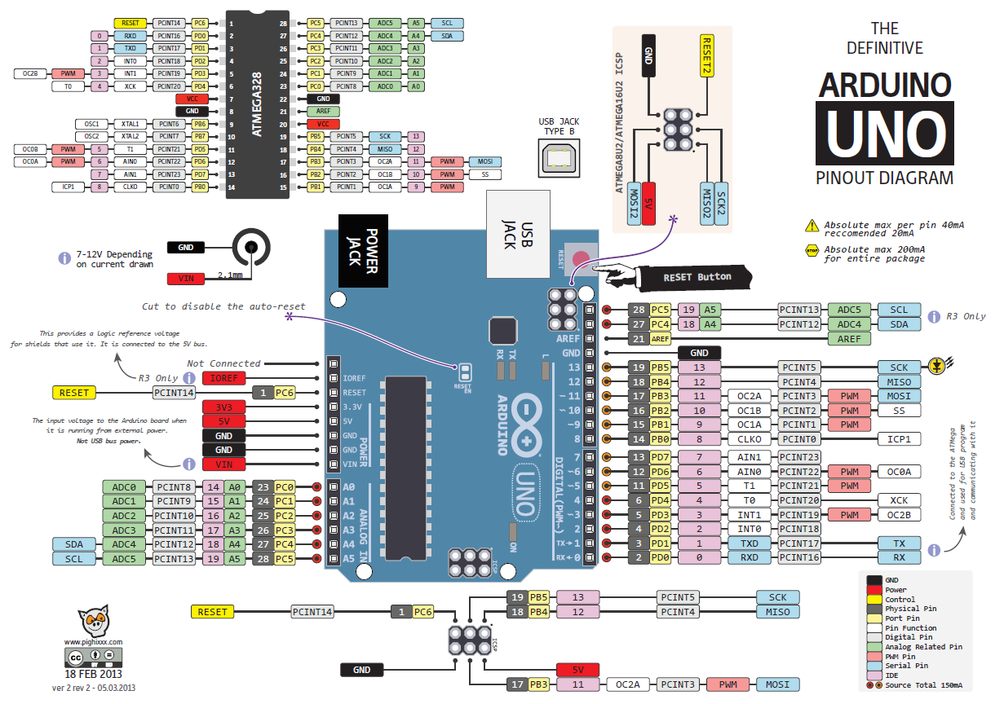

Slide 4
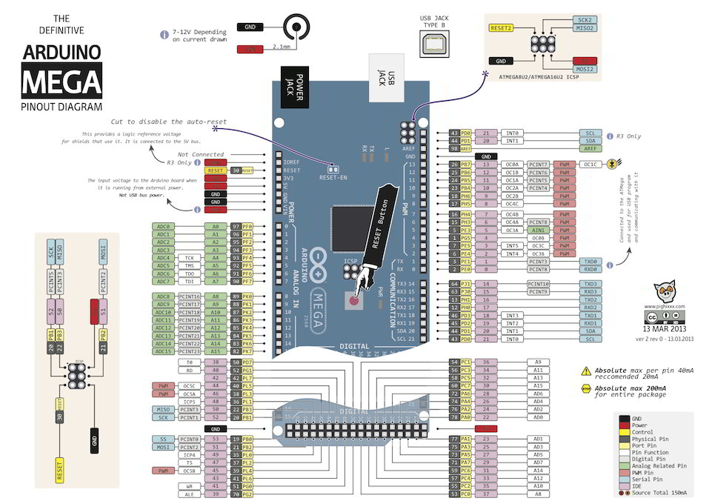

Slide 5
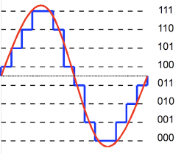
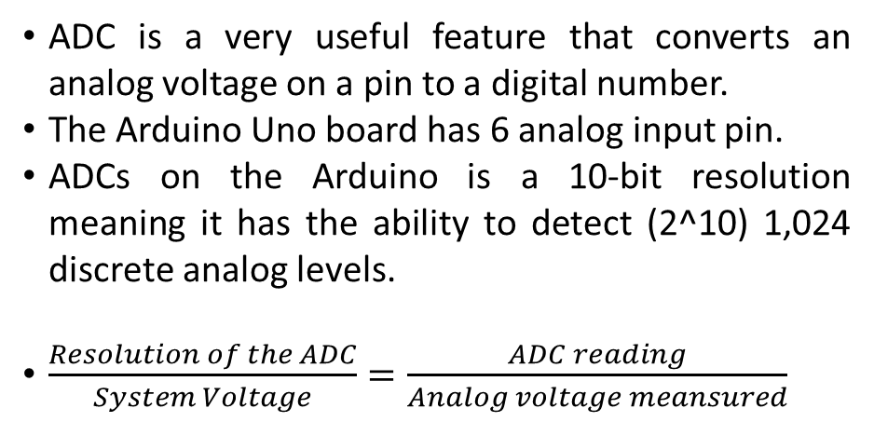
ADC – Analog to Digital Converter
ADC is a very useful feature that converts an analog voltage on a pin to a digital number.
The Arduino Uno board has 6 analog input pin.
ADCs on the Arduino is a 10-bit resolution meaning it has the ability to detect (2^10) 1,024 discrete analog levels.
$\frac{Resolution of the ADC}{System Voltage}=\frac{ADC reading}{Analog voltage meansured}$
ADC with 8 steps resolution 2^3 = 8

Slide 6
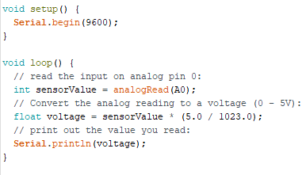
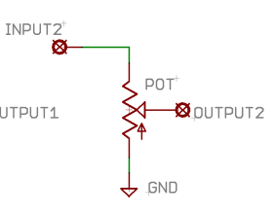
Simple Analog input read using Arduino Library
Reading Analog input
5V
A0

Slide 7
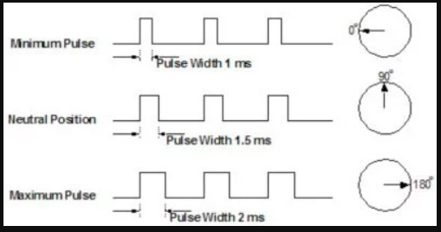
SERVO
Working principle
There is a minimum pulse, a maximum pulse, and a repetition rate.
The servo motor expects to see a pulse every 20 milliseconds (ms) and the length of the pulse will determine how far the motor turns.
A 1.5ms pulse will make the motor turn to the 90° position.
Shorter than 1.5ms moves it in the counter clockwise direction toward the 0° position.
Any longer than 1.5ms will turn the servo in a clockwise direction toward the 180° position.
More reading:
https://www.jameco.com/jameco/workshop/howitworks/how-servo-motors-work.html

Slide 8
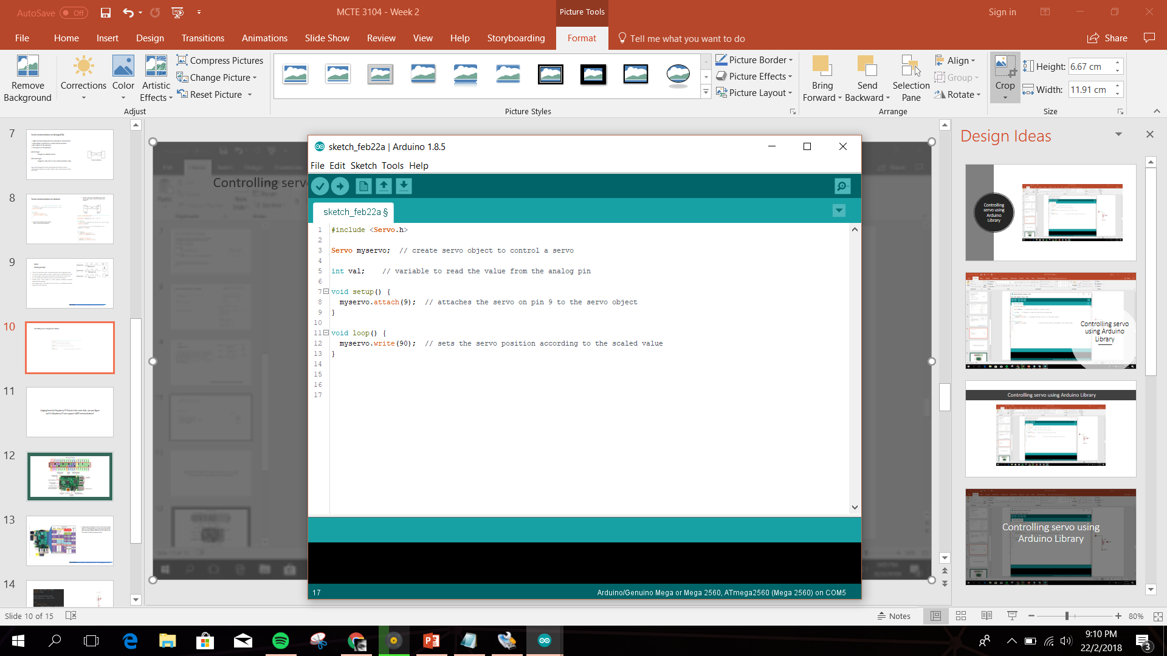
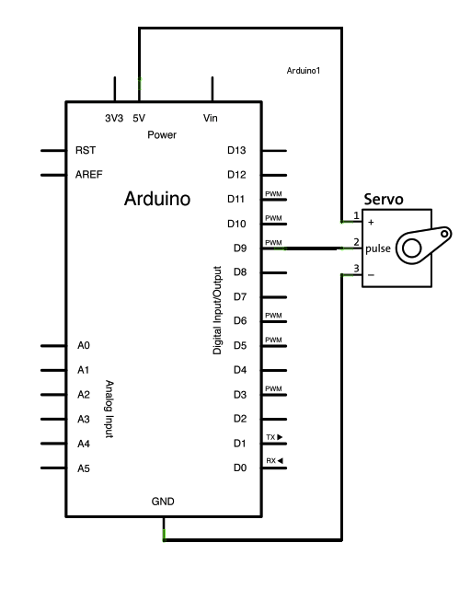
Controlling servo using Arduino Library

Slide 9
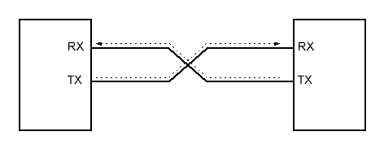
Serial communication on Atmega328x
UART (Universal Asynchronous Receiver Transmitter)
Full duplex asynchronous serial communication
• RX at pin0 on the Arduino
• TX at pin1 on the Arduino
Advantages
Simple and Bidirectional
Disadvantages
Supports only one to one communication only
Note: while Atmega328x has only one hardware UART feature, Arduino ‘SoftwareSerial’ allows you to enable ‘software’ UART communication on other pins as well.
Connection configuration

Slide 10
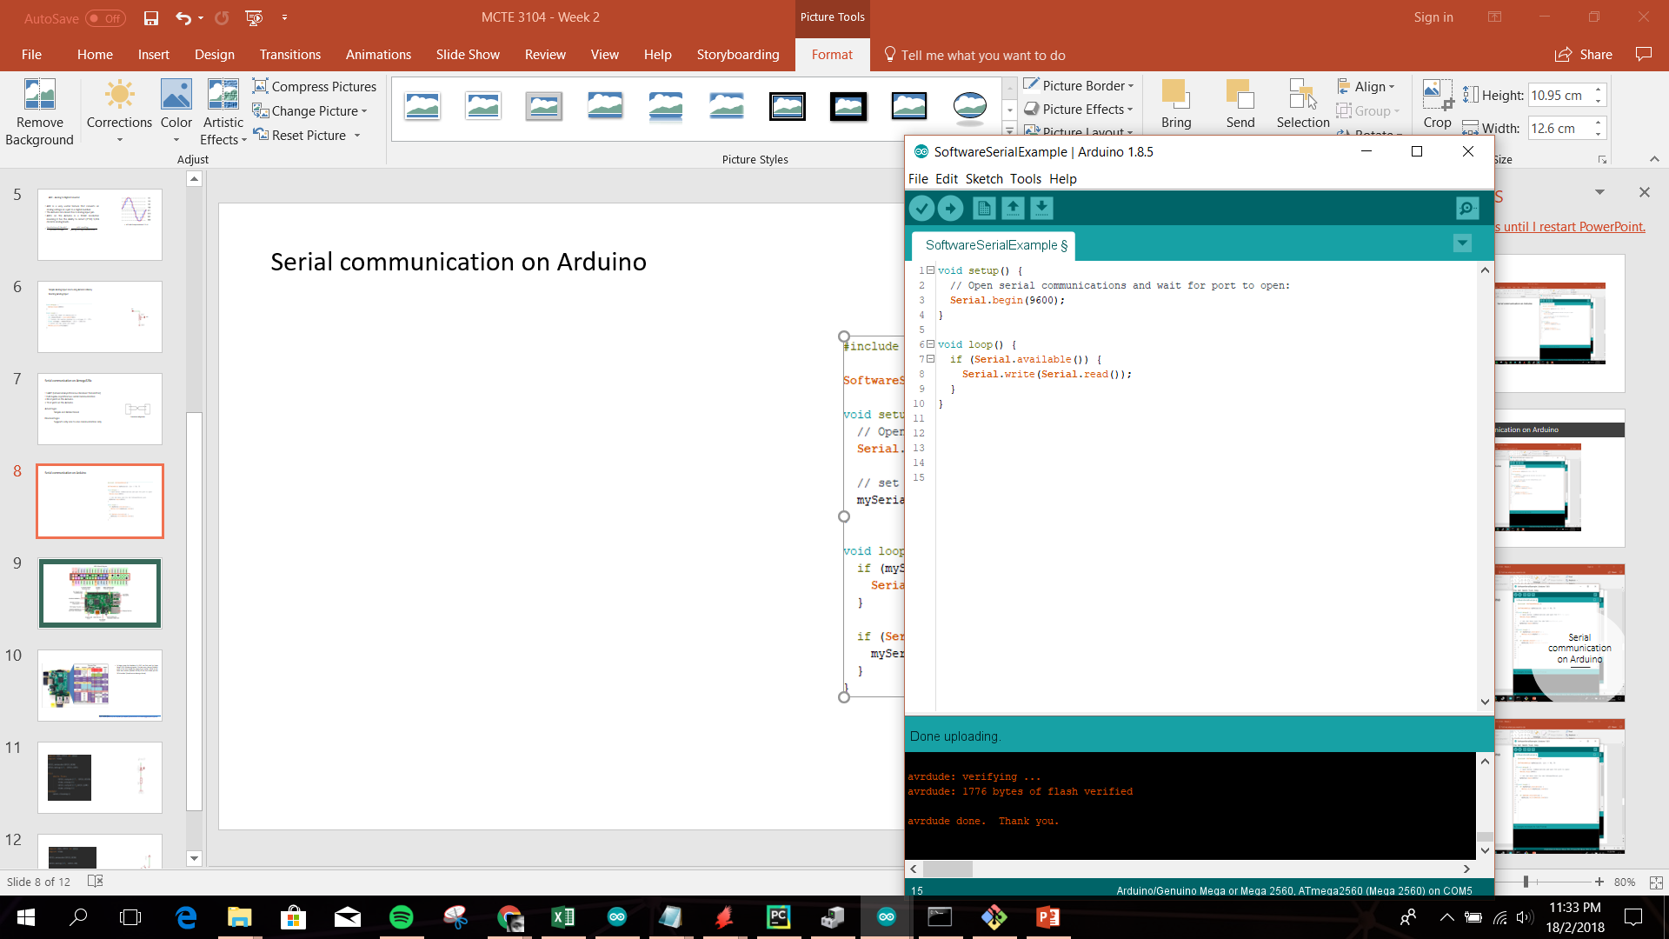
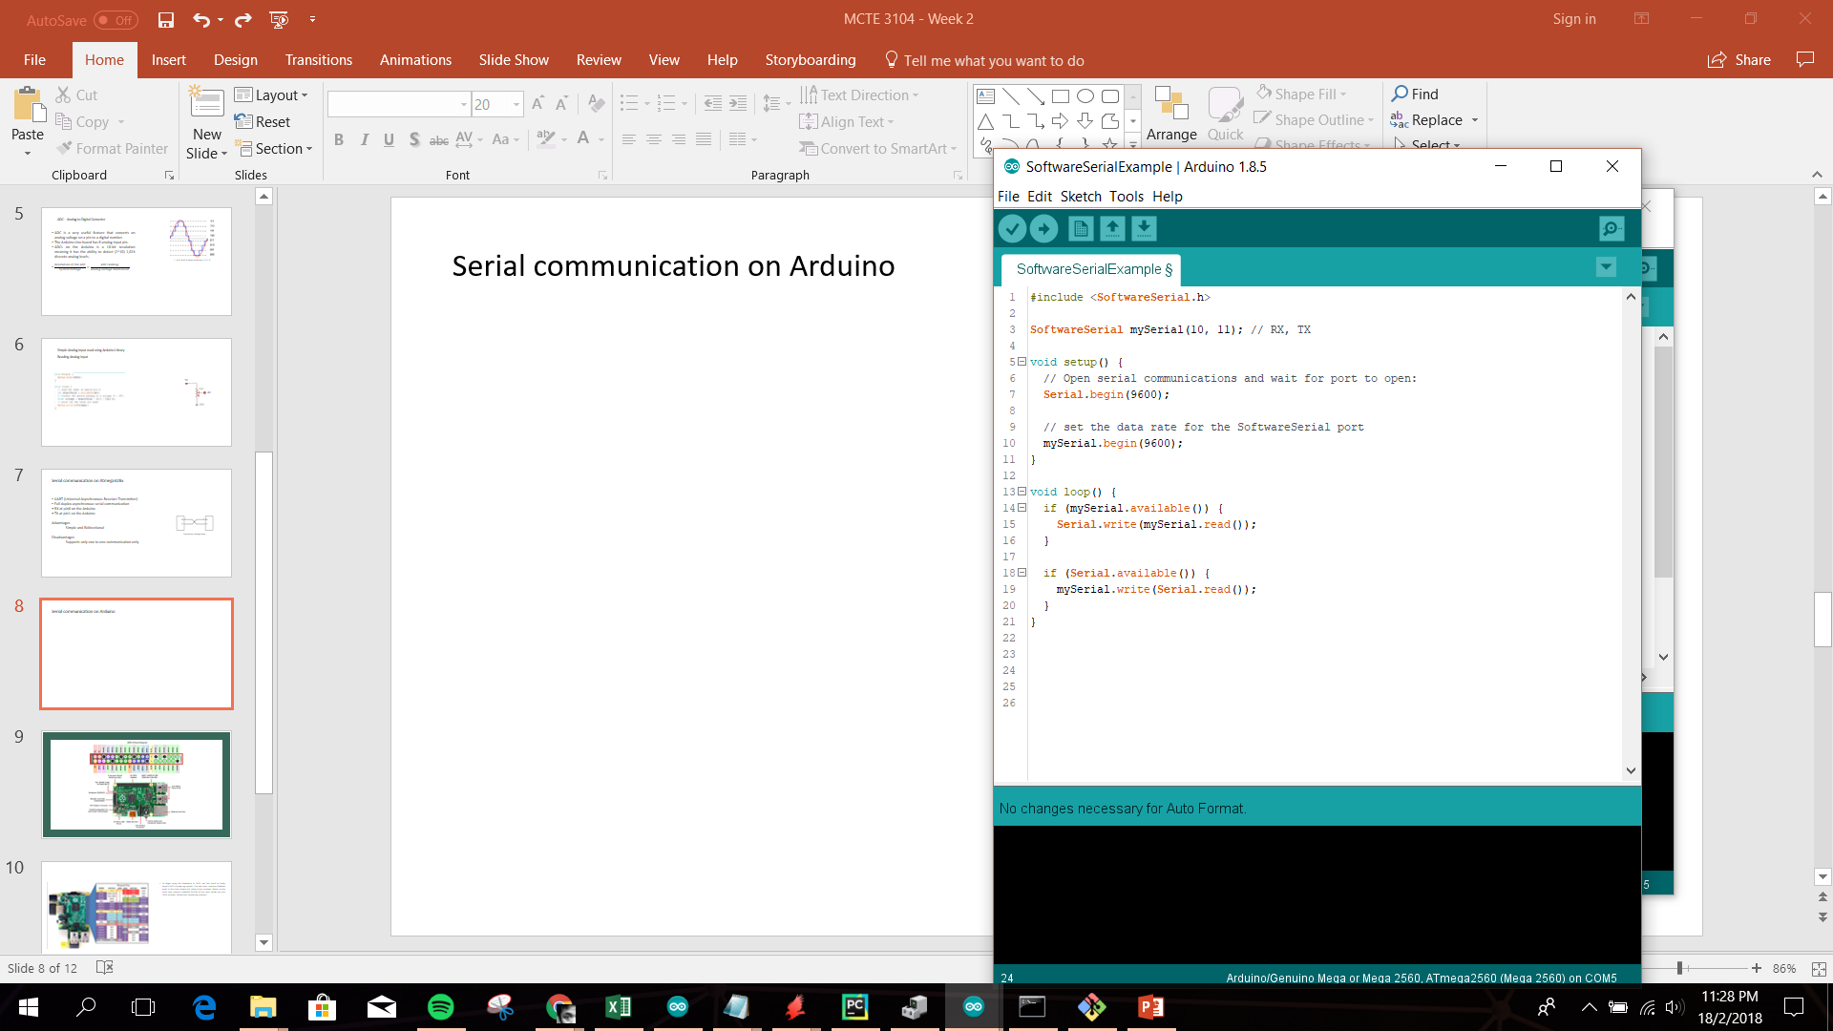
Serial communication on Arduino
Connect 2 Arduinos as the following and run the code on both devices. Observe and explain what happened?
10
10
11
11
Arduino
Arduino
Run this code and open the serial monitor. Observe and explain what happened?

Slide 11
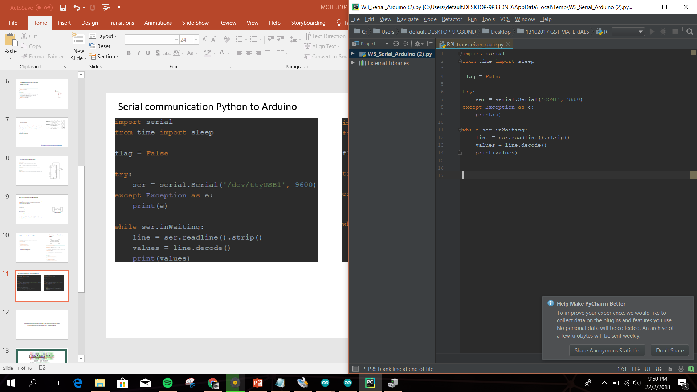
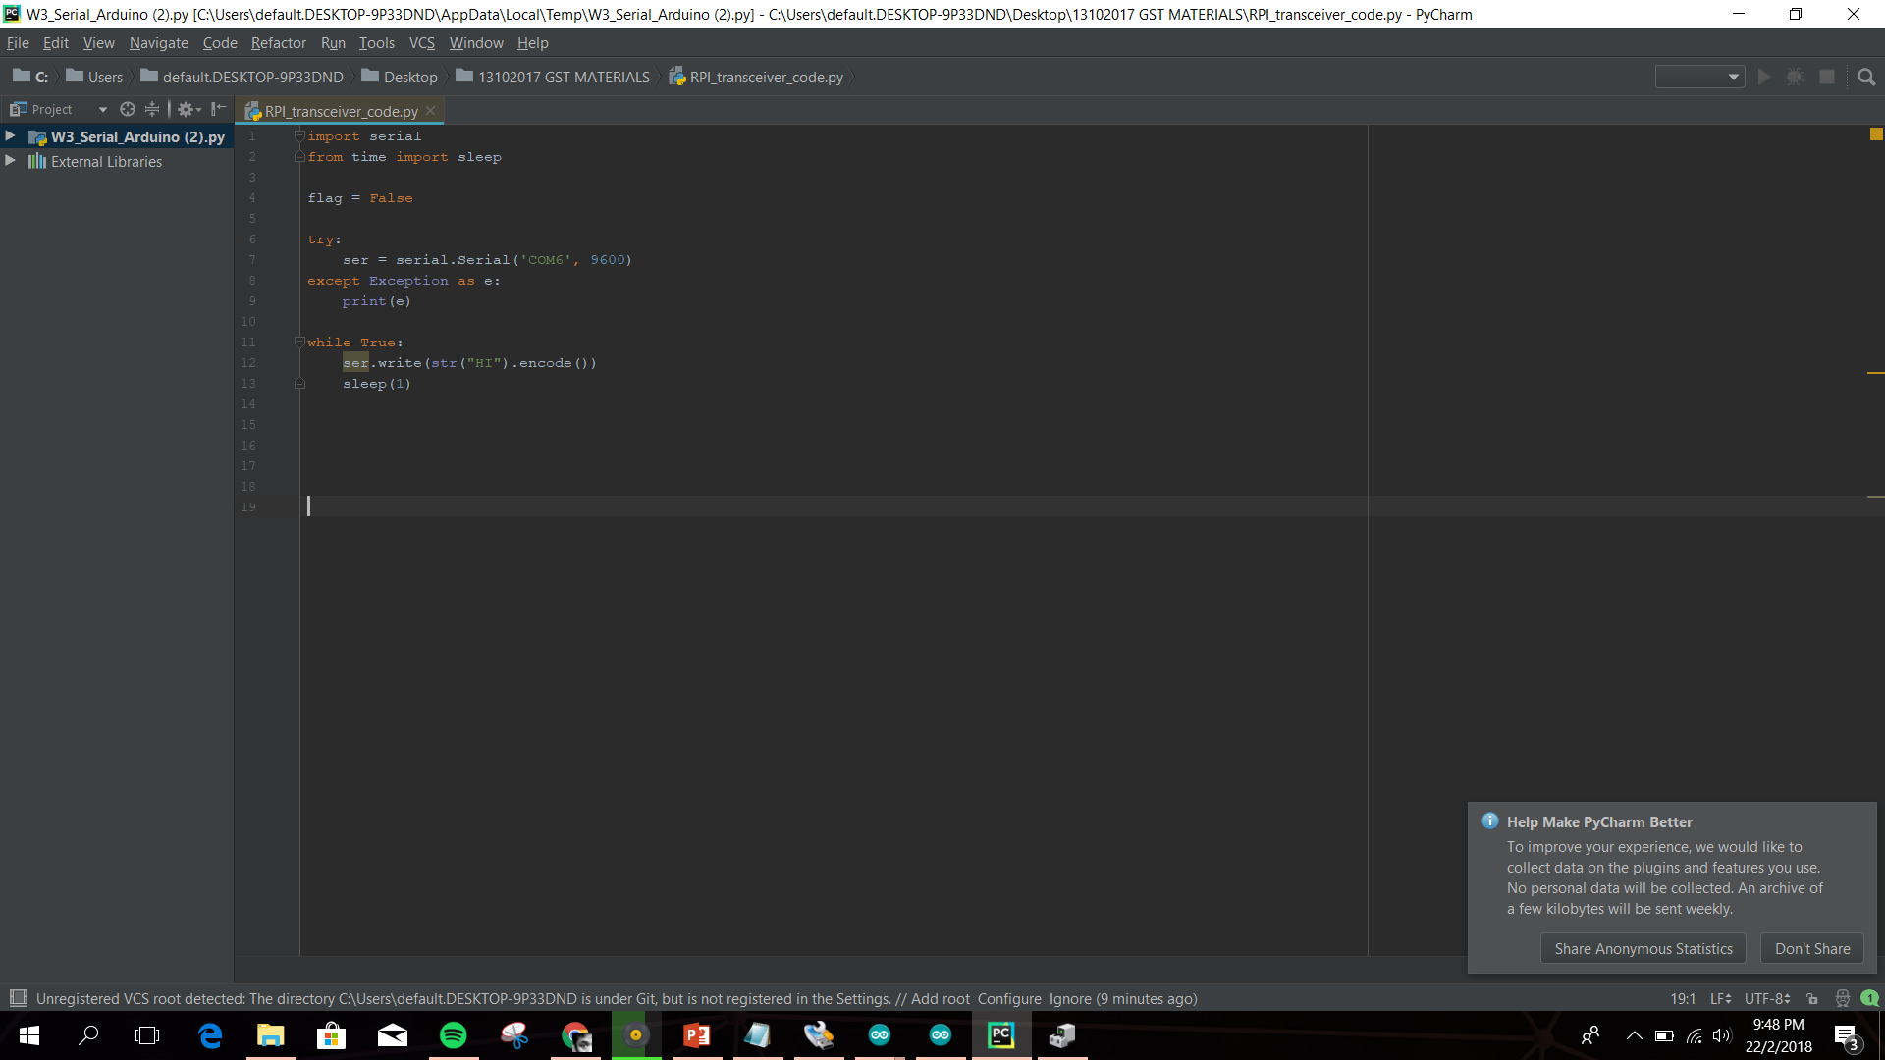
Serial communication Python to Arduino

Slide 12
Judging from the Raspberry Pi Pinout in the next slide, can you figure out if a Raspberry Pi can support UART communication?
ls /dev/tty*

Slide 13
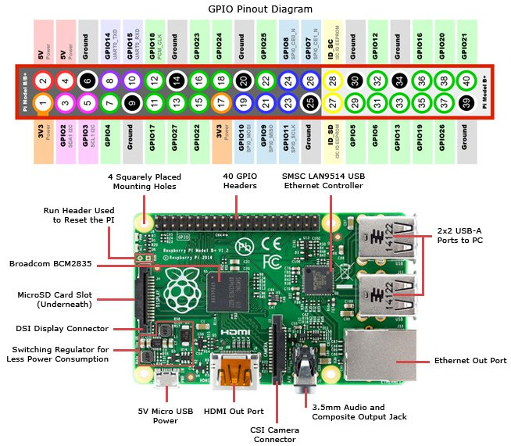

Slide 14
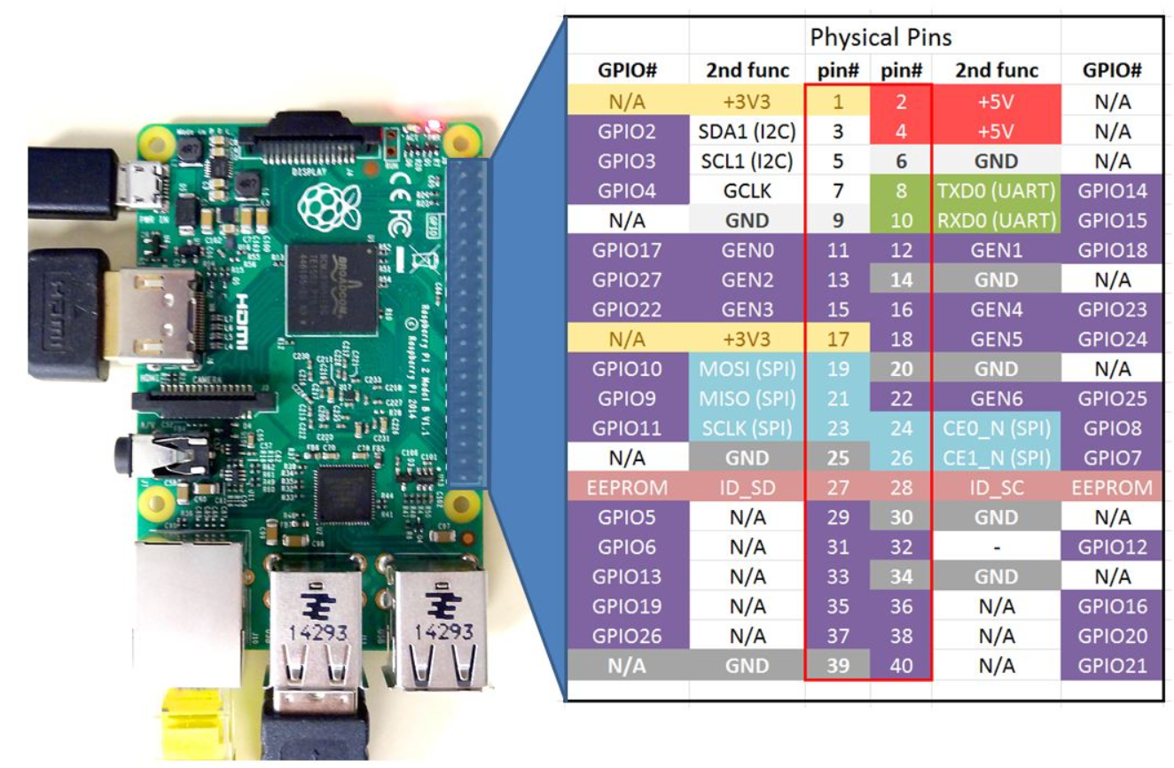
To begin using the Raspberry Pi GPIO, we first need to know Raspi's GPIO numbering system. The two inner columns (labelled pin#) in the chart shows the ‘physical pin number’ where as the outer two columns (labelled GPIO#) of the chart shows you the ‘BCM number’ (Broadcom numbering scheme).
Picture taken from
http://www.toptechboy.com/raspberry-pi/raspberry-pi-with-lesson-26-controlling-gpio-pins-in-python/

Slide 15
Use the same Python code on the raspi to communicate with the Arduino.
Hint: you need to change the ‘COMx’ bit of the code to the one raspi establishes.
Use this command to list all COM port in raspi: ls /dev/tty*

